Slide 1

Understanding the professional development needs of online educators: Expansive learning and transformative agency in a Change Laboratory intervention
Session 1 – 10 November 2020
Jane Nodder - PhD Researcher
Technology Enhanced Learning & E-Research

Slide 2
Outline of Session
Introductions, recap of background, concepts & research questions
Task 1: Expansive Learning Cycle – Step 1 - Questioning
Task 2: Identifying tensions in the Activity Systems model
Task 3: Reflection
Questions, close & next steps

Slide 3
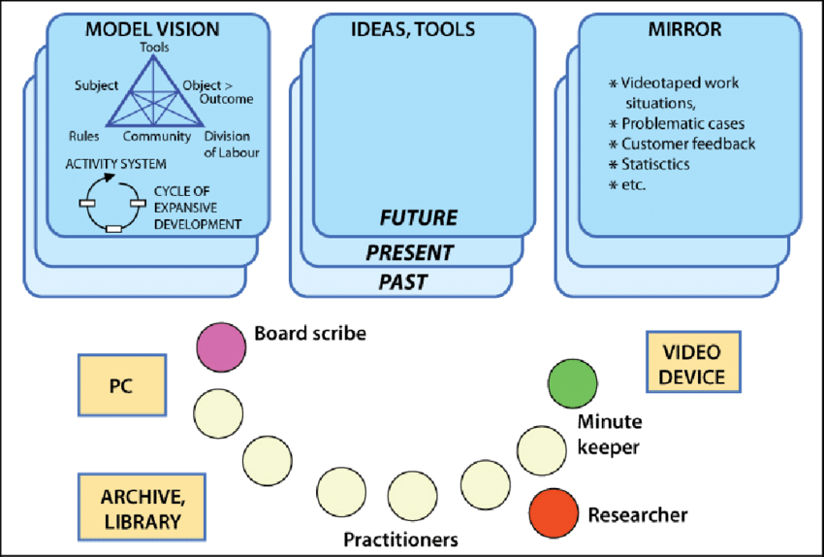
Change Laboratory - Organisation
Three boards
Three people
(Source: Santally, Cooshna-Naik & Conruyt, 2014)

Slide 4
Engeström’s Cycle of Expansive Learning
fosters collective engagement & moves from the ‘abstract to the concrete’ (Engeström et al., 1996)
allows people to consciously re-imagine their activity
Adapted from: Virkunnen and Newnham, 2013, p51; Engeström, Virkkunen,Helle, Pihlaja & Poikela, (1996); Englund, 2018, p701

Slide 5
Engeström’s Activity System model
Tools
Physical objects and systems that people use to accomplish the activity
Can model both the current & the future Activity System
Motives
Purposes, reasons for the activity
Subject
Person or people engaged in activity who are the focus of a study on activity
Object
Aim of the activity
Outcome
Results produced by the whole activity system
Rules
Laws, codes, conventions, customs and agreements that people adhere to while engaging in the activity
Community
People and groups whose knowledge, interest, stakes and goals shape the activity
Division of labour
How the work in the activity is divided among participants in the activity
Adapted from: Engeström, 1987

Slide 6
Research Questions
Designed to identify:
how online educators in UK HEIs use a CL intervention to generate an understanding of the factors that influence their professional development needs at different career stages
how a CL intervention helps online educators develop collective transformative agency for innovating practice regarding professional development within & across Activity Systems
how the CL can be developed for synchronous use in the online research environment

Slide 7
Mirror Data (Example)
Well-developed professional development programmes may increase faculty loyalty & satisfaction & are key to the continued success of HE
A strategic approach to professional development encourages structured, ongoing input as part of an online educator’s role & responsibilities
Supporting online educators to master the complexity of their role throughout their careers:
improves efficiency & effectiveness
increases job satisfaction & wellbeing
builds organisational capacity
provides a richer overall T&L experience for learners & educators

Slide 8
Mirror Data (Example) – Professional Development of Online Educators
Overall, professional development for online educators has not kept pace with the increasing shift towards online education
Most new online instructors start with little to no preparation for the online classroom
Online educators who are not prepared are less likely to help students engage with peers, collaborate on learning activities & cultivate a sense of community
Amongst 821 institutions:
90% offered a website with resources and some form of tech support
53% offered synchronous training
32% offered formal mentoring
Herman (2012 )
Educators are particularly looking for:
support with online pedagogy & how to design their teaching for an online format.
space to reflect on how to teach & create collaborative activities that engage students online
strategies for building online presence
Most professional development for online educators has been somewhat ad hoc, ineffective and disconnected to their teaching goals and needs
Educators are often left to their own devices to figure out what it means to be an effective online instructor. Many feel limited in their ability to teach & support online learners.
Challenges of the online T&L environment can leave the most experienced classroom educator feeling somewhat unprepared to create & develop their online presence.

Slide 9
Mirror Data (Example) – Professional Development of Online Educators
Competency frameworks, strategies & models have not been designed for online educators by online educators
Many initiatives focus on individual institutions missing opportunities to move beyond the culture of one organisation
Overall lack of practical tools for online educators to analyse their individual development needs & identify solutions during their career
Little focus on those factors that drive the PD needs of more experienced online educators at different stages in their career.
Focus of PD often somewhat ad-hoc & disjointed with an emphasis on a ‘one size fits all’, top-down model of training in technology & tools for instructional design
Many interventions direct educators to generic training & development resources involving self-paced, independent study. Reduces potential to connect online educators in a learning community
On-campus delivery of PD initiatives arguably unsuitable for educators working entirely online who are often geographically dispersed without access to a physical space

Slide 10
Task 1: Step 1 in the Expansive Learning Cycle: Questioning
What sparked your interest in exploring the topic of professional development for online educators in this Change Lab?
What would you like to gain from your time in this Change Lab?
Are there elements of the mirror data that resonate with your own experience of professional development as an online educator? If so, which?
Can you share a concrete example of your experience of professional development as an online educator?

Slide 11
Engeström’s Activity System model
Tools
Physical objects and systems that people use to accomplish the activity
Can model both the current & the future Activity System
Motives
Purposes, reasons for the activity
Subject
Person or people engaged in activity who are the focus of a study on activity
Object
Aim of the activity
Outcome
Results produced by the whole activity system
Rules
Laws, codes, conventions, customs and agreements that people adhere to while engaging in the activity
Community
People and groups whose knowledge, interest, stakes and goals shape the activity
Division of labour
How the work in the activity is divided among participants in the activity
Adapted from: Engeström, 1987

Slide 12
Task 2: Plotting the Activity System(s) Model
What works well with regard to your professional development as an online educator?
Where do you see the main tensions in your role & institution with regard to your professional development as an online educator?
Personal reflection – 5-10 mins
Group discussion – 10-15 mins

Slide 13
Task 3: Step 6: Reflection on the CL intervention
How did you find this CL experience?
What was helpful/worked well?
What was less helpful/worked less well?
How did you find the online process?

Slide 14
Next Steps & Questions
add outputs from scribe to Googledrive folder for sharing
reflection on session & next session (analysis)
if you wish (not compulsory) – keep notes of any thoughts/reflections that come to mind before the next session
date of next session: 24 Nov 2020, 10am-12 noon

Slide 15
References
Engestrom, Y. (1987). Learning by Expanding: An Activity Theoretical Approach to Developmental Research. Helsinki, Finland: Orienta-Konsultit.
http://lchc.ucsd.edu/mca/Paper/Engestrom/Learning-by-Expanding.pdf
Engeström, Y., Virkkunen, J., Helle, M., Pihlaja, J., & Poikela, R. (1996). The change laboratory as a tool for transforming work. Lifelong Learning in Europe, 1(2), 10-17. https://doi.org/10.1080/1360144X.2018.1478837
Englund, C. (2018). Exploring interdisciplinary academic development: the Change Laboratory as an approach to team-based practice. Higher Education Research & Development, 37(4), p701
Santally, M. I., Cooshna-Naik, D., & Conruyt, N. (2014). A model for the transformation of the Mauritian classroom based on the Living Lab concept. In 2014 IST-Africa Conference Proceedings (pp. 1-10). IEEE. DOI: 10.1109/ISTAFRICA.2014.688060
Virkkunen, J. & Newnham, C. S. (2013). The Change Laboratory: A tool for collaborative development of work and education. Sense Publishers. Rotterdam

Slide 16

Thank You
Any Questions: j.nodder@lancaster.ac.uk

