Slide 1
Editable Activity Systems
Rob Miles

Slide 2
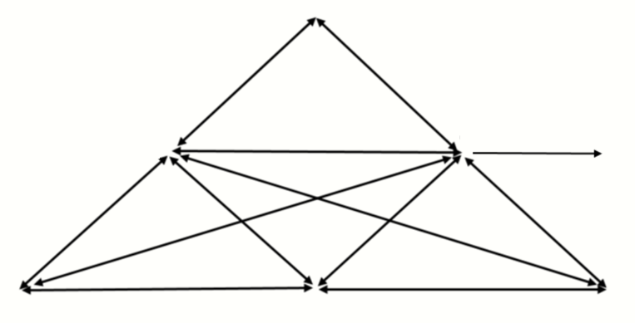
Tools
Add text here
Object
Add text here
Subject
Add text here
Outcome
Add text here
Division of labour
Add text here
Rules
Add text here
Community
Add text here
Notes:
Editable activity system with editable text box labels

Slide 3
Notes:
Blank editable activity system. Annotate using pen tools in whiteboard software or using pen tool in PowerPoint.

Slide 4
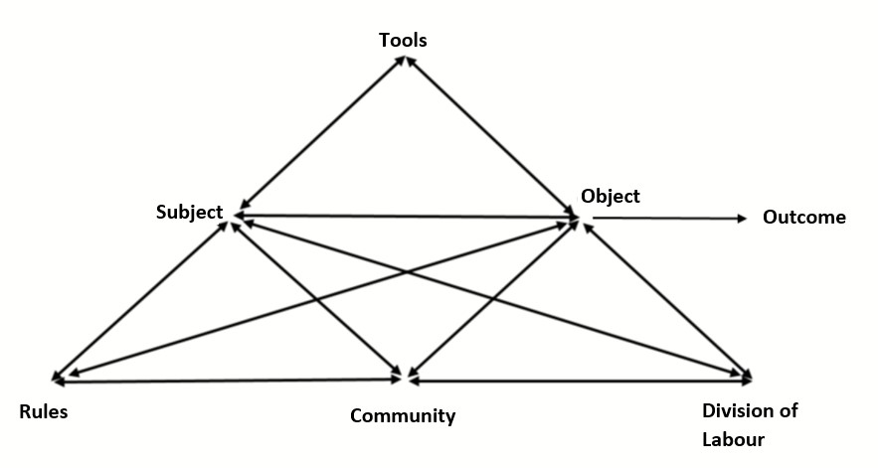
Notes:
Editable activity system with non editable labels. Annotate using pen tools in whiteboard software or using pen tool in PowerPoint.

Slide 5
Primary contradiction within elements
Secondary contradiction between elements
Tertiary contradiction between different versions of the same activity system, e.g. old and new model
Quaternary contradiction between neighbouring activity systems
Contradiction in Object partly shared between two intersecting activity systems
Notes:
Editable activity system with graphical representations of systemic contradiction symbols

Slide 6
Primary contradiction within elements
Secondary contradiction between elements
Tertiary contradiction between different versions of the same activity system, e.g. old and new model
Quaternary contradiction between neighbouring activity systems
Contradiction in Object partly shared between two intersecting activity systems
Notes:
Primary contradiction

Slide 7
Primary contradiction within elements
Secondary contradiction between elements
Tertiary contradiction between different versions of the same activity system, e.g. old and new model
Quaternary contradiction between neighbouring activity systems
Contradiction in Object partly shared between two intersecting activity systems
Notes:
Secondary contradiction

Slide 8
Primary contradiction within elements
Secondary contradiction between elements
Tertiary contradiction between different versions of the same activity system, e.g. old and new model
Quaternary contradiction between neighbouring activity systems
Contradiction in Object partly shared between two intersecting activity systems
OLD MODEL
NEW MODEL
Notes:
Tertiary contradiction

Slide 9
Primary contradiction within elements
Secondary contradiction between elements
Tertiary contradiction between different versions of the same activity system, e.g. old and new model
Quaternary contradiction between neighbouring activity systems
Contradiction in Object partly shared between two intersecting activity systems
System 2
System 1
Notes:
Quaternary contradiction

Slide 10
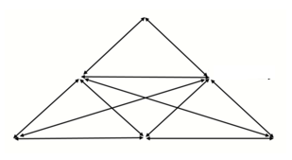
Primary contradiction within elements
Secondary contradiction between elements
Tertiary contradiction between different versions of the same activity system, e.g. old and new model
Quaternary contradiction between neighbouring activity systems
Contradiction in Object partly shared between two intersecting activity systems
Notes:
Contradiction in partly shared object

Slide 11
References
Bligh, B., & Flood, M. (2015). The Change Laboratory in Higher Education: research-intervention using activity theory. In J. Huisman & M. Tight (Eds.), Theory and method in higher education research (pp. 141-168). Emerald Group Publishing Limited.
Engeström, Y. (1987/2015). Learning by expanding: An activity-theoretical approach to developmental research (2nd ed.). Cambridge University Press.
Miles, R. (2020). Making a Case for Cultural Historical Activity Theory: Examples of CHAT in Practice. Studies in Technology Enhanced Learning, 1(1).
Miles, R. (2021a). A Change Laboratory: A collective approach to addressing issues in laptop-mediated English language classrooms Lancaster University].
Miles, R. (2021b). Identifying the contradictions in the technology enhanced language classroom. Seminar.net, 17(01). https://doi.org/10.7577/seminar.3199
Miles, R. (2022). The insider Change Laboratory in practice. Studies in Technology Enhanced Learning.

